Slide 1
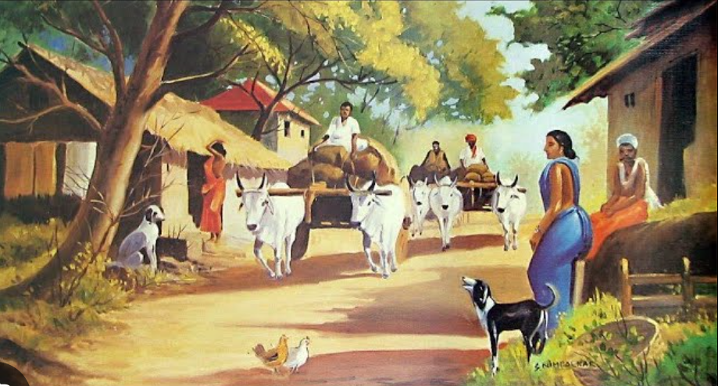
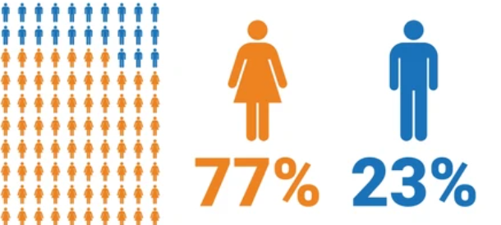
"Human Gender Ratio: Global and Indian Perspective "
Understanding the Ratio of Male to Female Worldwide

Slide 2
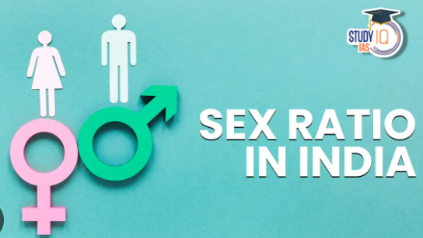
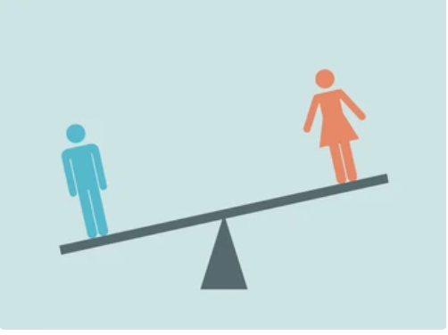
What does the word Gender Ratio Refer to ?
The ratio between the number of males and females in a society is referred to as the gender ratio. This ratio is not stable but instead shaped by biological, social, technological, cultural, and economic forces.

Slide 3
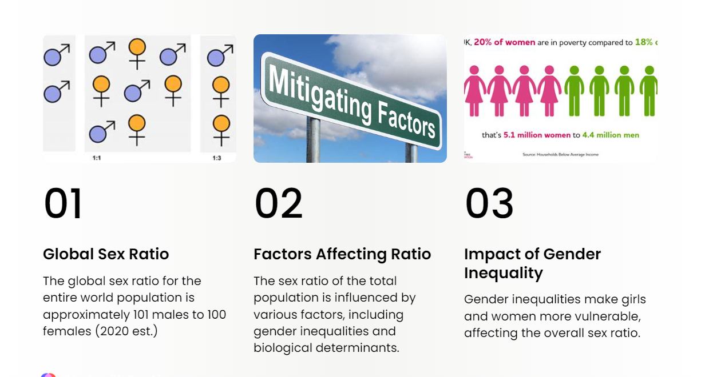
Some factors Affecting the Gender Ratio --

Slide 4
Indian Gender Ratio between India and World-
India
World
Overall Ratio:
Generally balanced, with a slight male birth advantage.
Regional Differences :
Varied gender ratios influenced by cultural and migration factors
Government Initiatives :
Various international initiatives promote gender equality.
Overall Ratio:
More men due to higher female mortality.
Regional Differences :
Significant differences in gender ratio across states.
Government Initiatives
"Beti Bachao, Beti Padhao" addresses gender disparities.

Slide 5
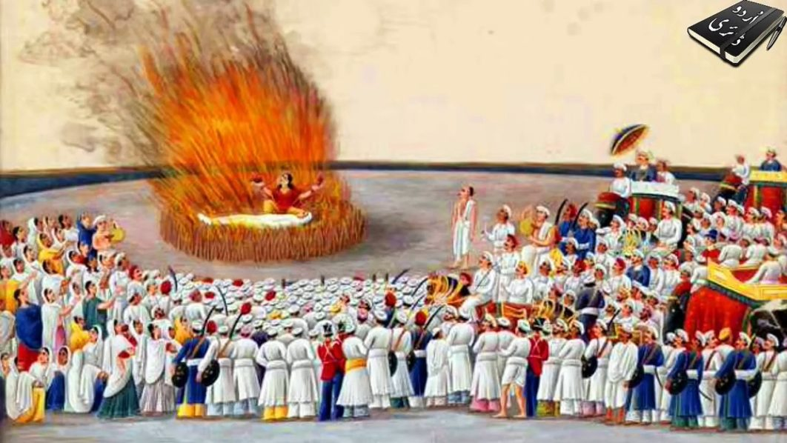



Some Facts About Gender Ratio -
As of previous data, Kerala is known for having one of the highest gender ratios in India, with more women than men.
Haryana has been reported to have one of the lowest gender ratios in India, with more men than women.
"Beti Bachao, Beti Padhao" is a significant government initiative aimed at addressing gender disparities and promoting the well-being and education of girls in India.
Widow or Sati Remarriage Act (1856): A landmark in Indian social reform, this act allowed Hindu widows to remarry, challenging traditional norms and impacting gender roles.

Slide 6
Case Study of –“Beti bachao, Beti padhao”
The "Beti Bachao, Beti Padhao" campaign, launched in 2015, aims to combat gender bias in India. It promotes education for girls, resulting in positive shifts. Challenges like cultural norms persist, emphasizing the ongoing need for sustained efforts in fostering gender equality.
This Campaign was started by
Prime Minister, Narendra Modi

Slide 7
Beti bachao, Beti padhao” The story
Background (Why it started):
In 2015, India launched "Beti Bachao, Beti Padhao" to fix the problem of fewer girls being born and to make sure they get a good education.
Objective (What they wanted to do):
The main goal was to change people's minds about preferring boys and to ensure that girls have the opportunity to receive a proper education, especially in areas where there were very few girls.
Implementation: Raised awareness, enforced strict rules against prenatal gender determination, penalized violators. Provided financial aid to families, encouraging girls' education.

Slide 8
Impact: Positive shift in perceptions towards girls. Some regions experienced a rise in female births, with increased girls' school attendance and learning opportunities.

Slide 9
Thank you

